Slide 1



Noise, Instruction, and Cognitive Performance
Tristan Swatts
Mentor: Dr. Melissa Birkett
Northern Arizona University
NASA Space Grant
April 16, 2016

Slide 2
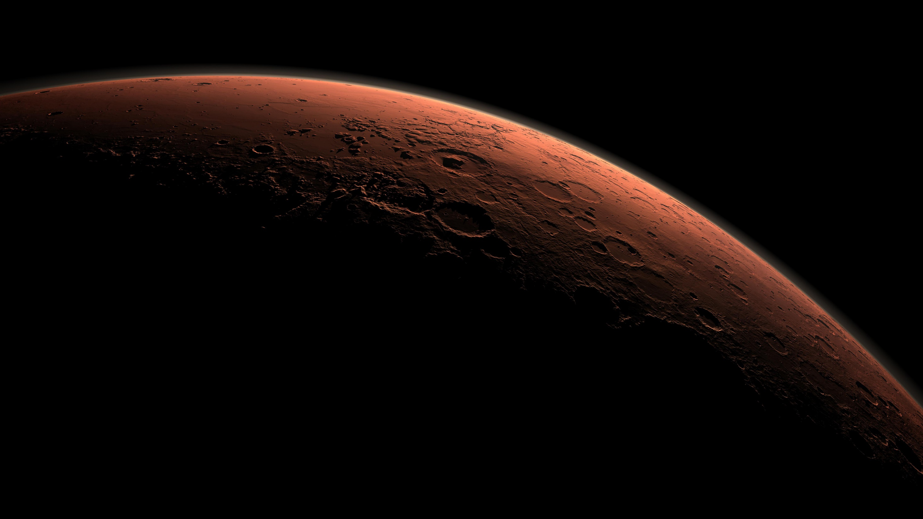
NASA Human Research Roadmap
2030 Mars Mission
NASA cannot eliminate all noise for their employees.
Noise can cause stress and impairs cognitive performance
    HPA/SAM systems
Question: Is there a simple way to improve cognitive performance in a noisy environment?

Slide 3

Unpredictable Noise and Cognitive Performance
  We want to know if instructing people to ignore the noise improves cognitive performance
  Hypothesis
      Instructing will improve performance.

Slide 4
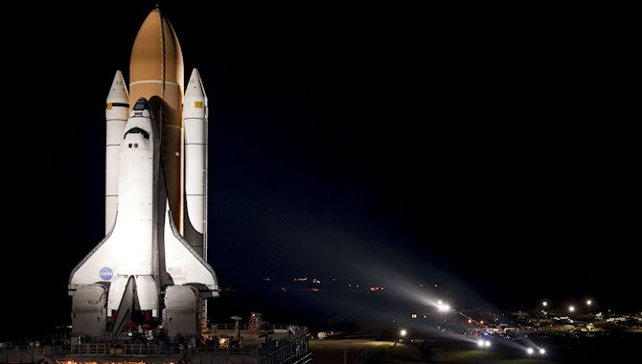
My Study
  Male and female participants from the NAU campus
  - Age
  - Health Requirements
  Participant Groups
  Production of Noise
  Cognitive Tasks
  Self-reported Questionnaire
  Physiological Response

Slide 5
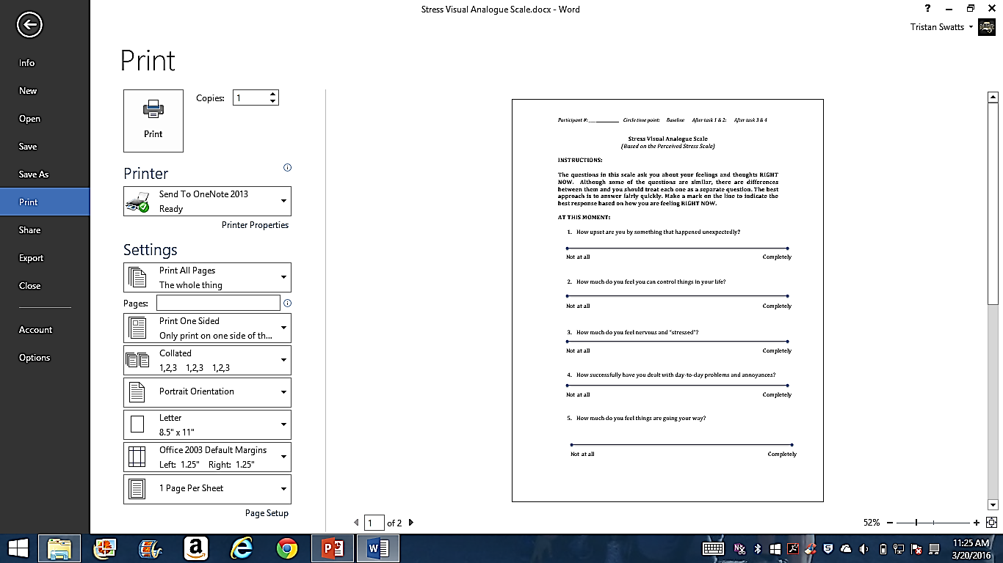
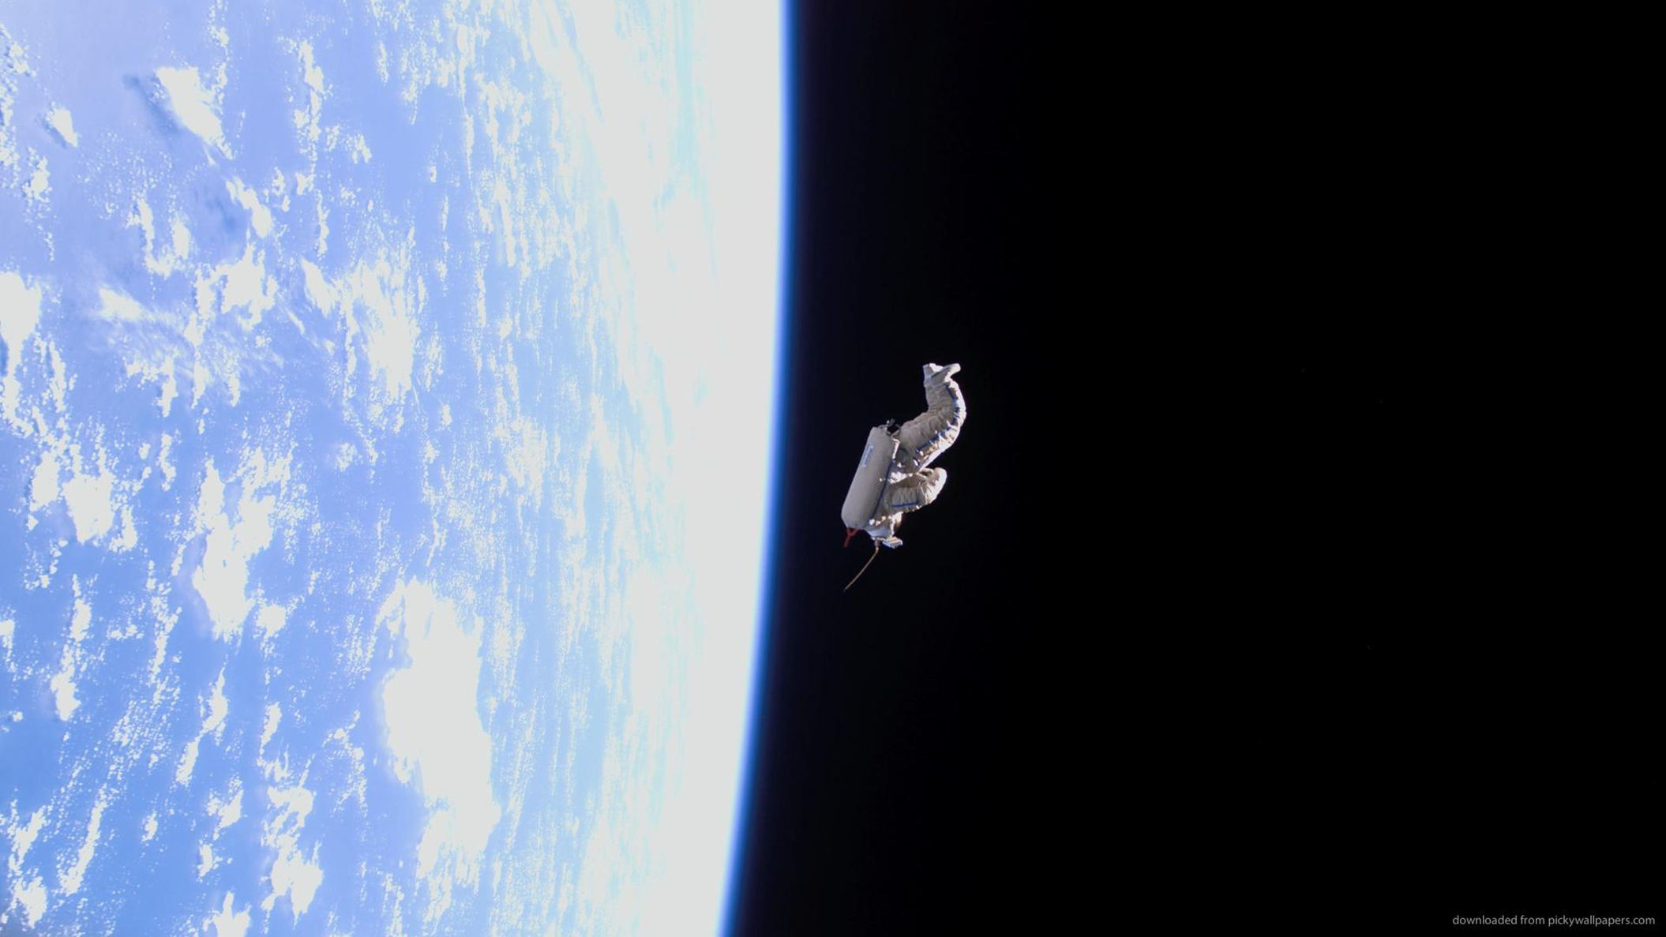
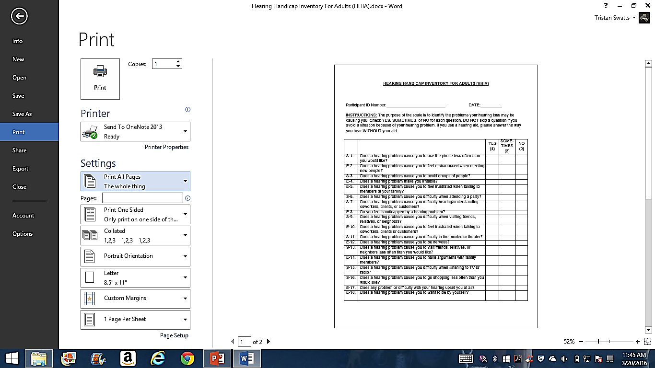


Slide 6
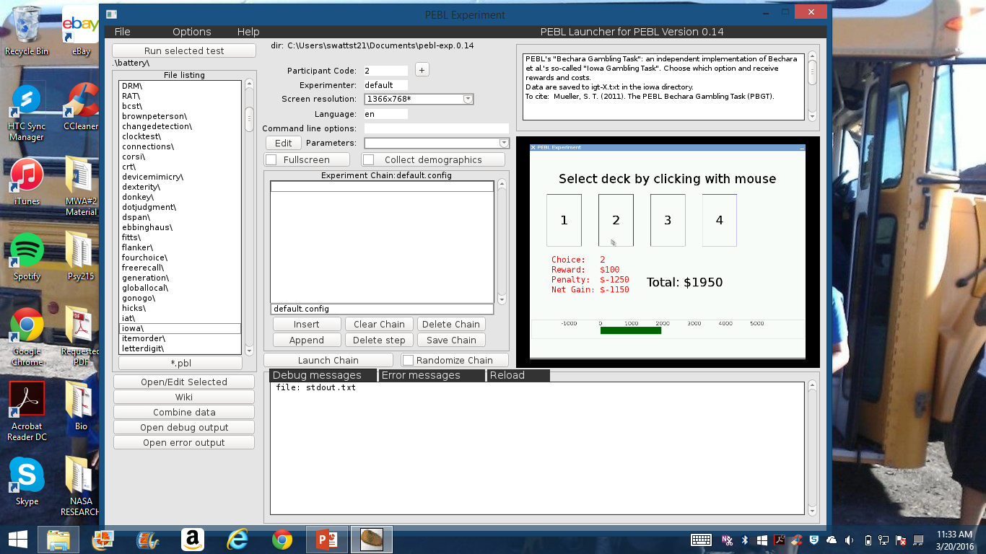
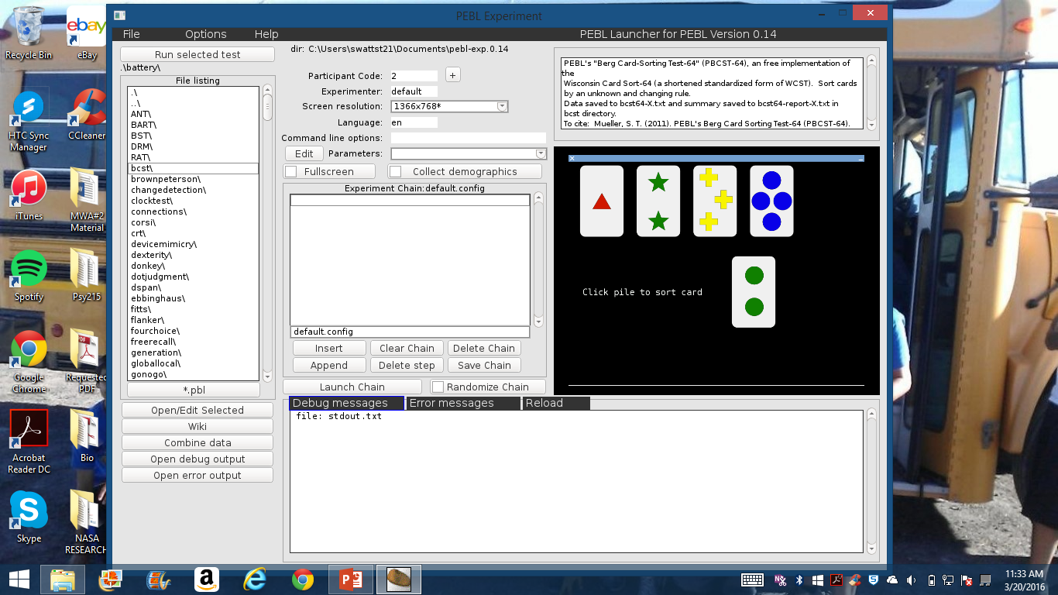
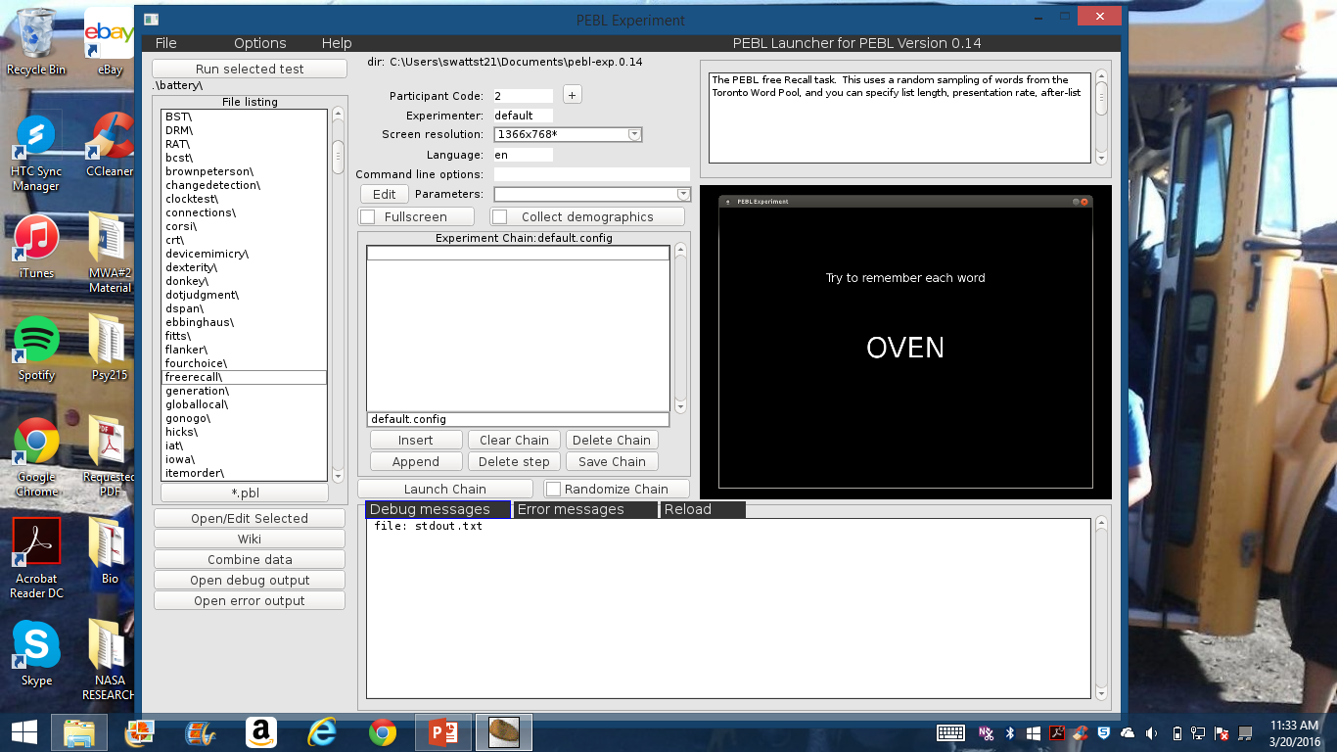

4
6
7

Slide 7

 | Control Group (n=5) | Noise Group (n=4) | Noise + Instruction Group (n=4)
Gender
Male (n) | 4 | - | 1
Female (n) | 1 | 4 | 3
Age (years)
18-19 (n) | 1 | 1 | 2
20-21 (n) | 4 | 3 | 2
HHI Total Score (mean±SD) | 7.60 (10.43) | 5.50 (6.81) | 0 (0)
NSS Total Score (mean±SD) | 14.4 (2.57) | 13.75 (3.40) | 14.25 (1.89)
P Value= Not Significant

Slide 8
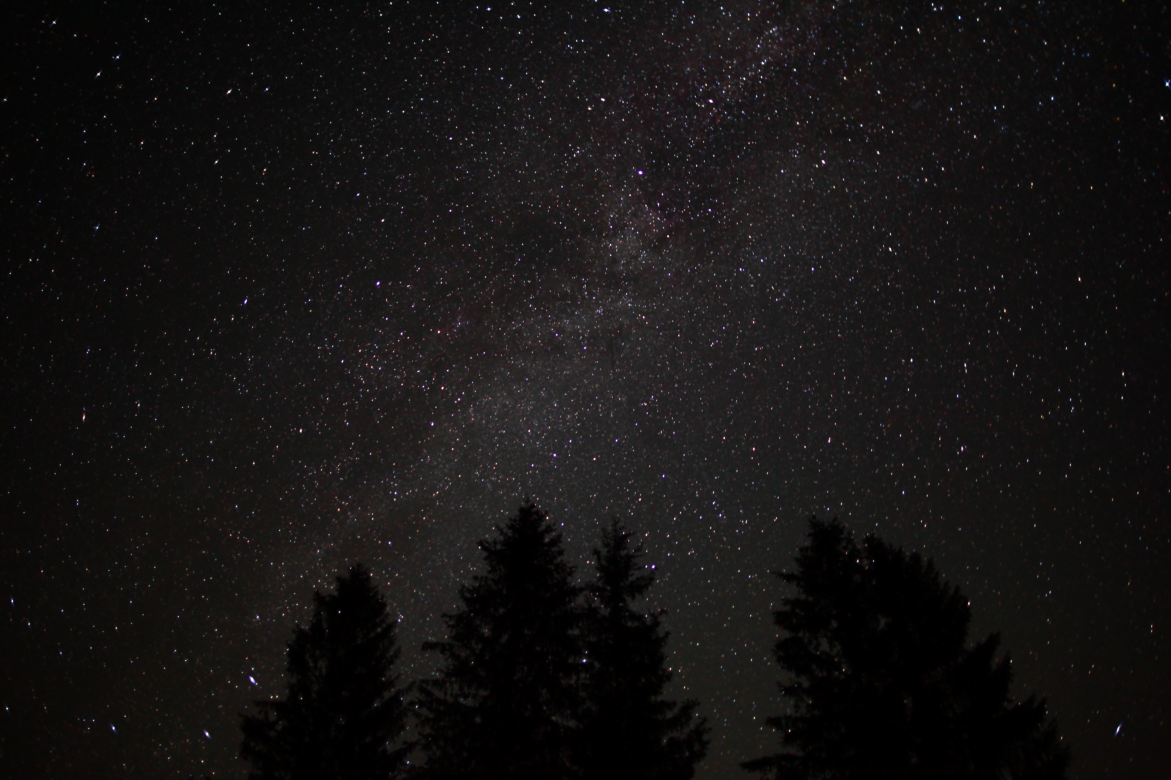
 | Control Group (n=4) | Noise Group (n=3) | Noise + Instruction Group (n=4) | p values
VAS Baseline (mean±SD) | 48.25 (11.88) | 58.46 (11.71) | 54.00 (10.65)
VAS During Task (mean±SD) | 43.93 (7.16) | 82.70 (32.47) | 58.65 (5.41) | P=.051
VAS Post Task (mean±SD) | 58.43 (14.98) | 60.63 (19.47) | 59.43 (5.05)

Slide 9
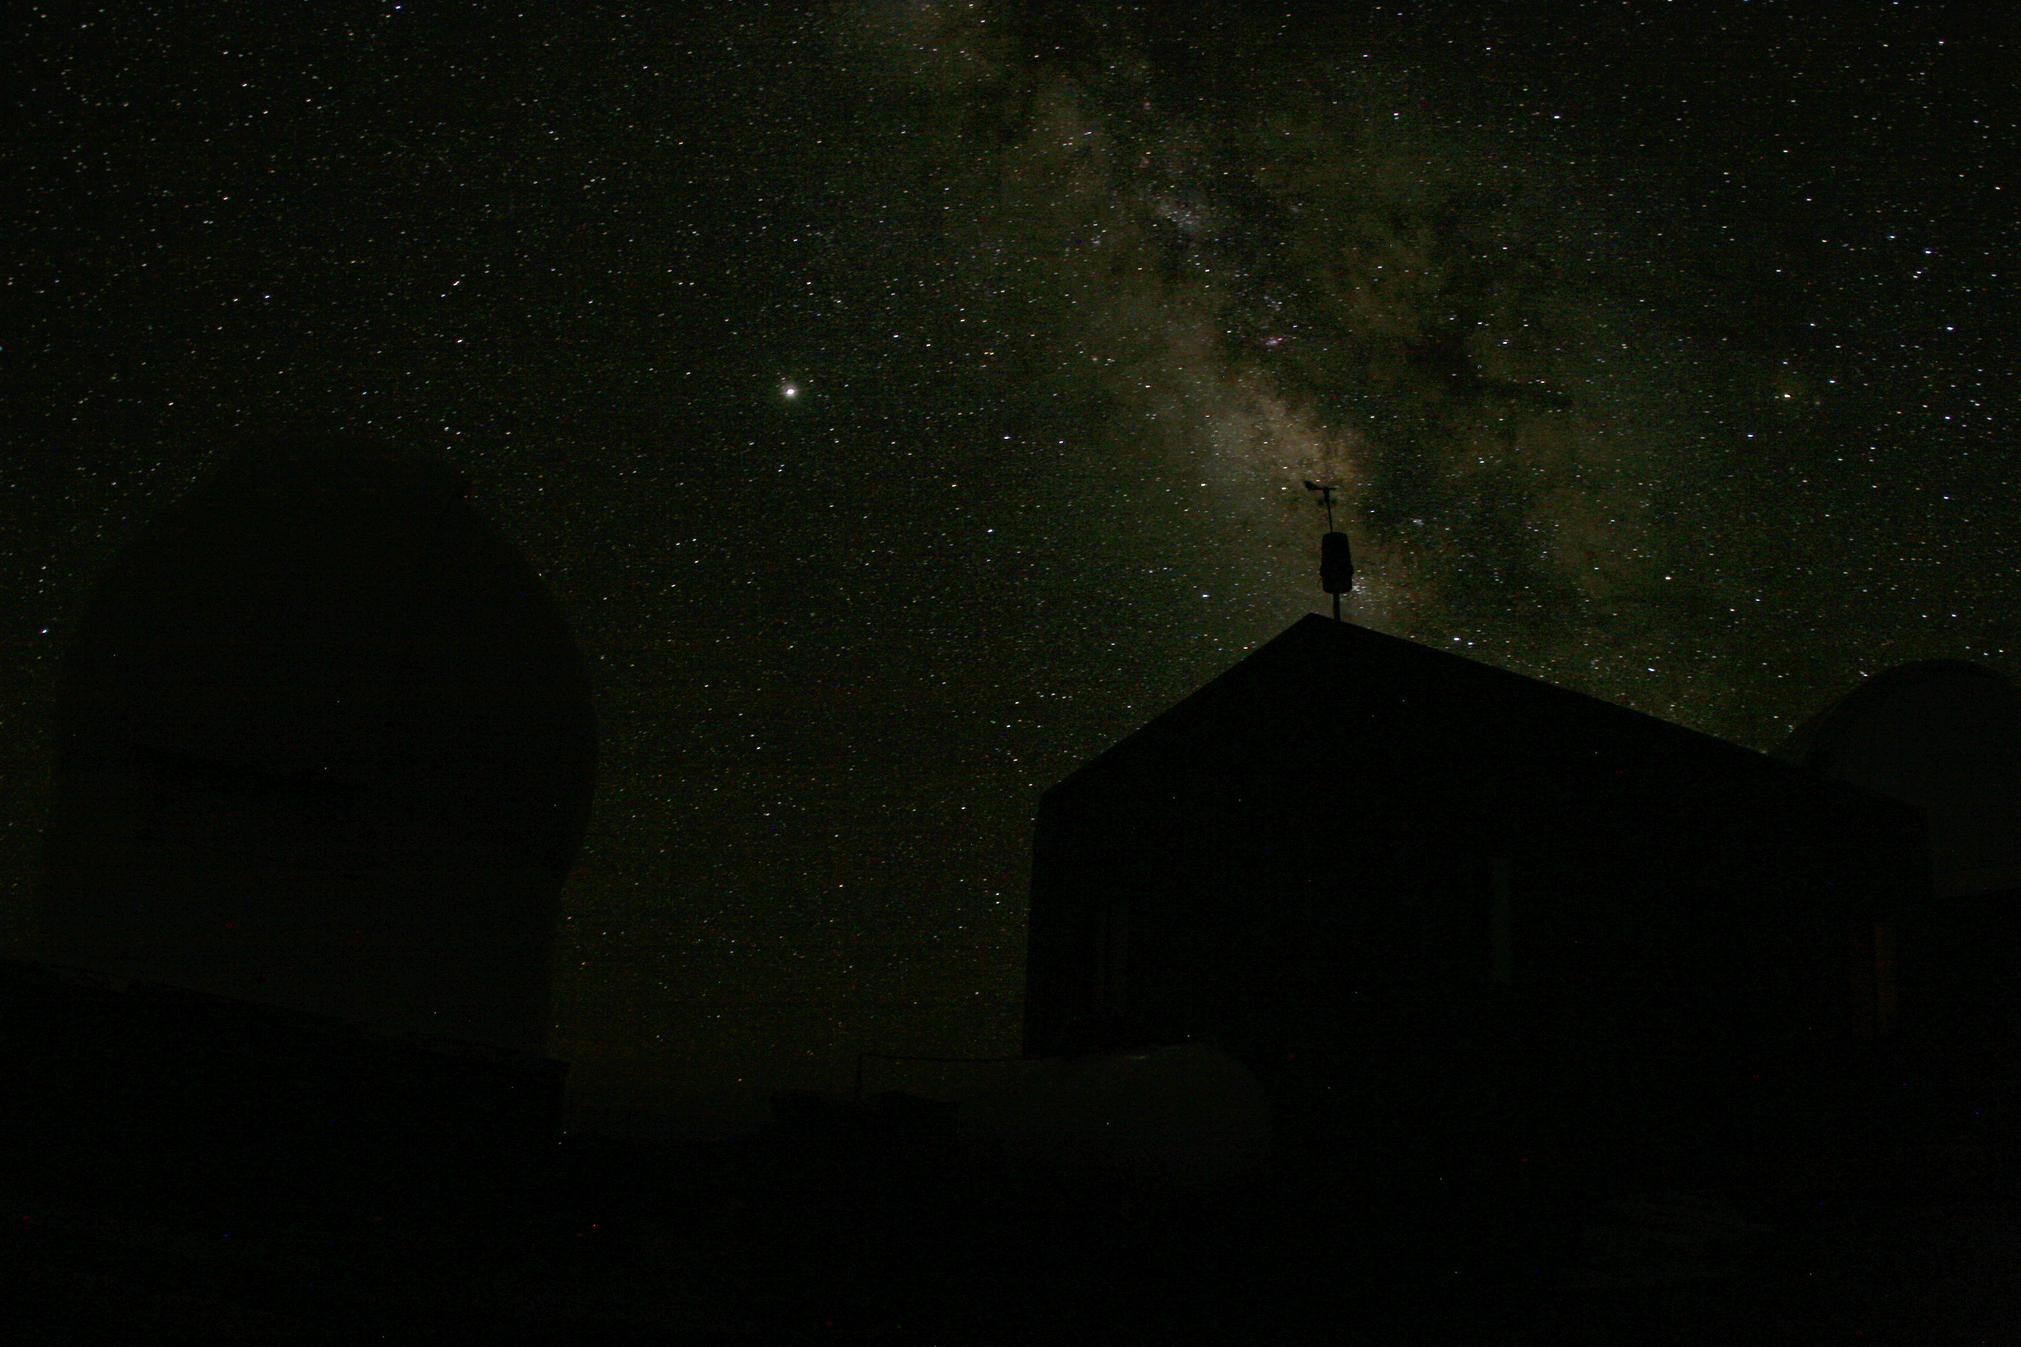
Systolic BP | Control Group (n=5) | Noise Group (n=3) | Noise + Instruction Group (n=4)
Baseline (mean±SD) | 116.4 (14.09) | 109.00 (1.80) | 103.00 (7.34)
During Task (mean±SD) | 112.1 (10.93) | 104.84 (3.75) | 102.88 (5.72)
Post Task (mean±SD) | 110.9 (9.08) | 109.17 (13.61) | 98.13 (7.35)
Diastolic BP | Control Group (n=5) | Noise Group (n=3) | Noise + Instruction Group (n=4)
Baseline (mean±SD) | 80.2 (3.93) | 71.17 (7.08) | 73.25 (3.79)
During Task (mean±SD) | 73.3 (10.97) | 67.17 (5.29) | 73.5 (4.78)
Post Task (mean±SD) | 73.6 (12.72) | 67.33 (10.59) | 72.13 (0.85)
Heart Rate | Control Group (n=5) | Noise Group (n=3) | Noise + Instruction Group (n=4)
Baseline (mean±SD) | 64.6 (11.67) | 73.17 (7.91) | 78.88 (8.32)
During Task (mean±SD) | 68.8 (15.34) | 73.5 (1.00) | 80.13 (12.59)
Post Task (mean±SD) | 65.00 (8.93) | 61.67 (3.33) | 80.88 (11.66)

Slide 10
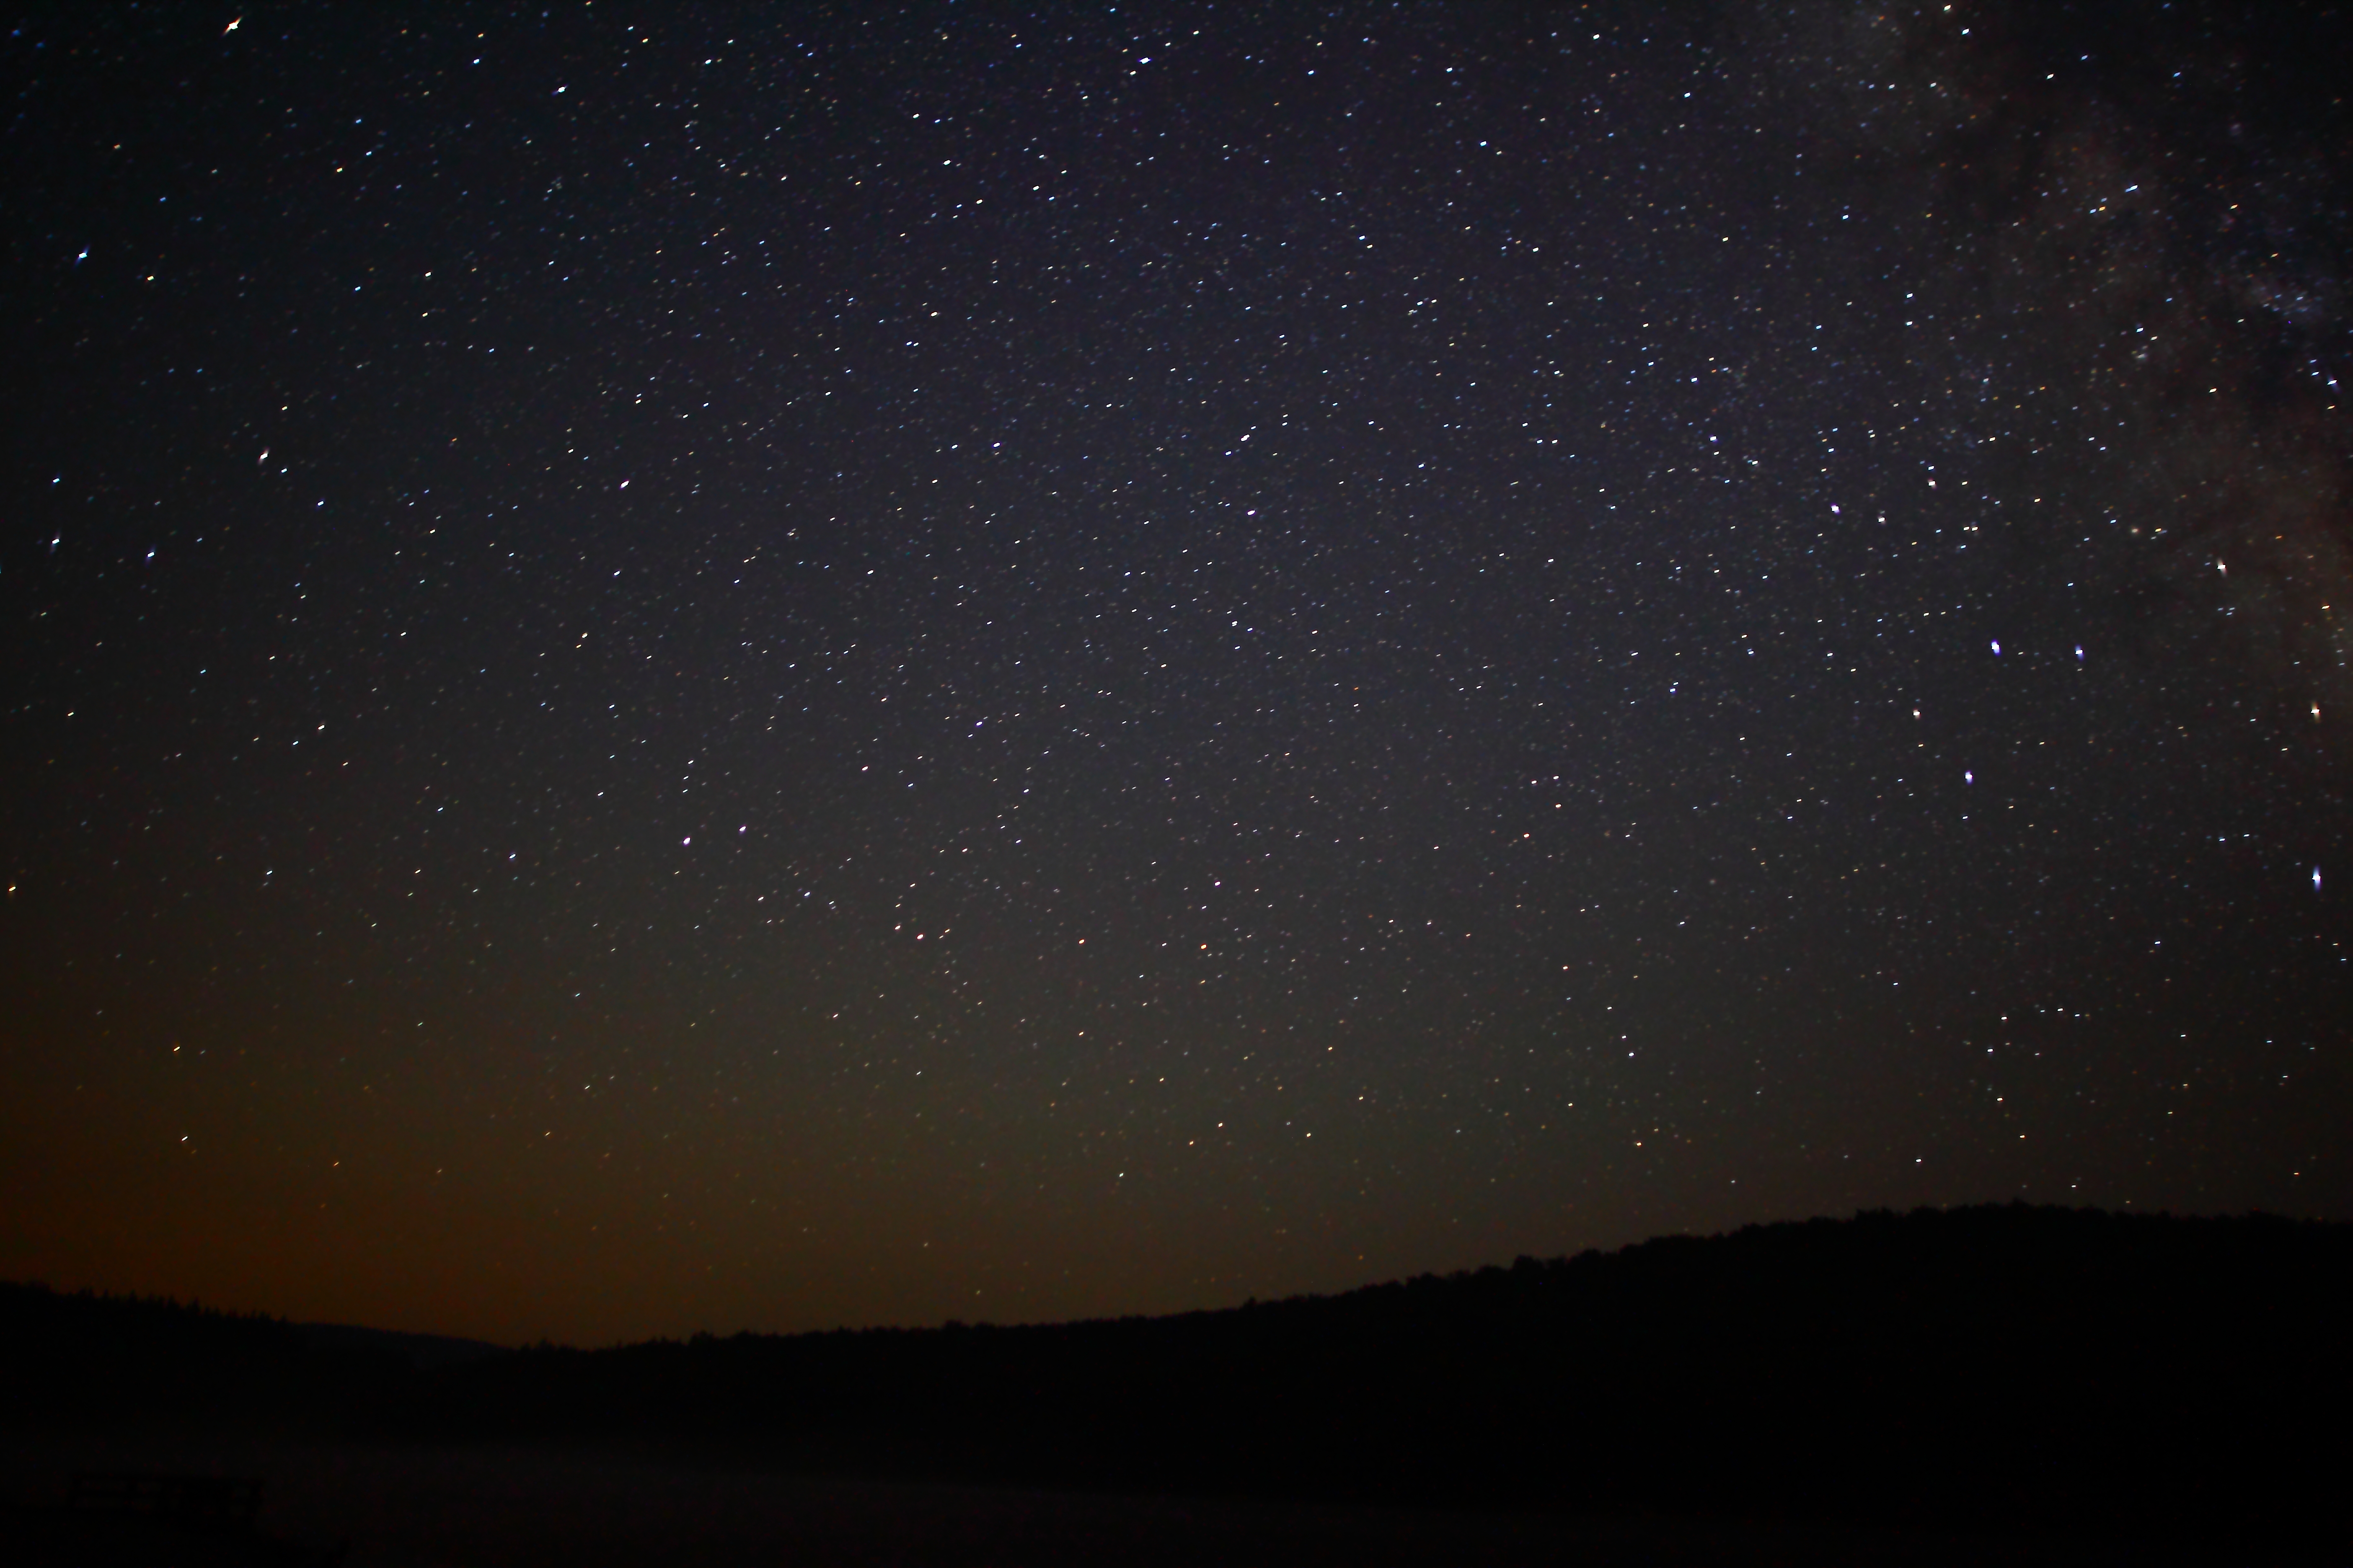
Free Recall | Control Group (n=5) | Noise Group (n=3) | Noise + Instruction Group (n=3) | p values
Correct (mean±SD) | 13.40 (3.91) | 12.33 (3.06) | 13.67 (1.15) | Not significant
Berg’s Card Sorting Test | Control Group (n=5) | Noise Group (n=3) | Noise + Instruction Group (n=3) | p values
Correct (mean±SD) | 88.6 (27.68) | 101.67 (5.86) | 92.25 (9.60) | Not Significant
Item Order | Control Group (n=5) | Noise Group (n=3) | Noise + Instruction Group (n=3) | p values
Number Correct (mean±SD) | 30.80 (0.84) | 20.25 (13.25) | 41.25 (22.57) | 0.167
Berchara’s Gambling Task | Control Group (n=5) | Noise Group (n=3) | Noise + Instruction Group (n=3) | p values
Advantageous Selections (C+D)-(A+B) (mean±SD) | -16.00 (26.90) | 45.5 (65.27) | 25.00 (38.12) | 0.158

Slide 11
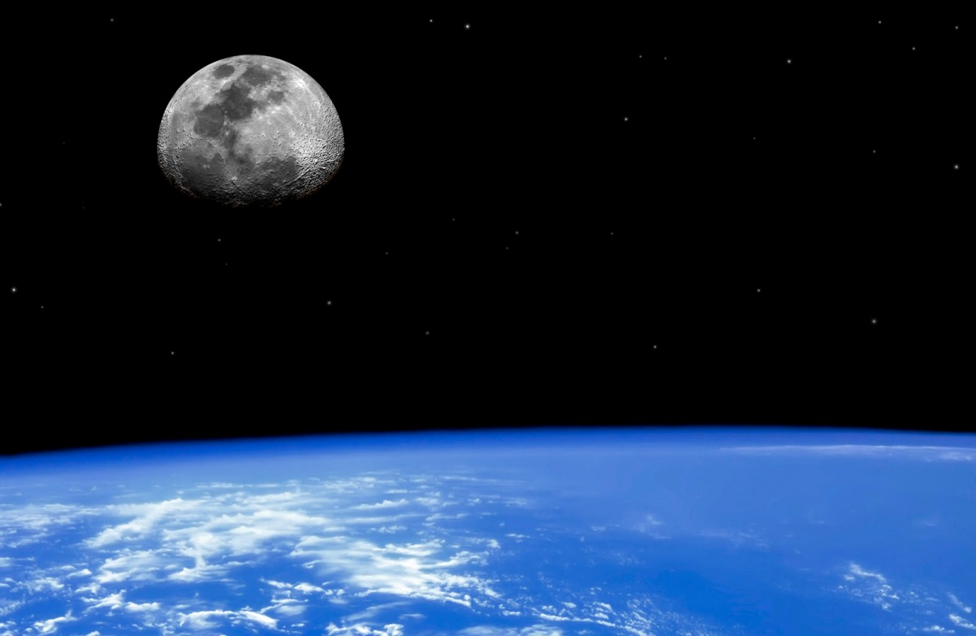
Discussion
Overall what does this mean for my research?
        No change between groups
        Small Sample Size
        Noise
        NASA?

Slide 12
Acknowledgments:
NAU/NASA Space Grant
Mentor: Dr. Melissa Birkett
Kathleen Stigmon
Dr. Nadine G. Barlow
Arizona Space Grant Consortium
Thank You!

